Slide 1
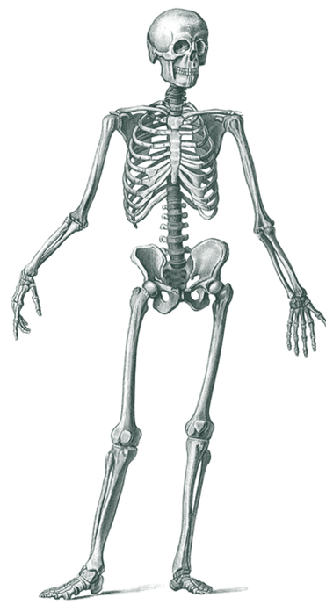
Organisms
Key vocabulary
Big picture
carbohydrate: (noun) A component of food that is high in energy; sugar, starch and fibre are all carbohydrates.
fibre: (noun) A type of carbohydrate that we cannot digest; it prevents constipation.
heart: (noun) The organ responsible for pumping blood around the body.
muscle: (noun) A part of the body that causes movement when it contracts.
organ: (noun) A part of the body that has a particular job to do.
protein: (noun) A component of food that helps your body grow and repair itself.
vitamin: (noun) An important part of our diet, needed in small amounts to keep us healthy.
An organism is an individual living thing, such as an animal, plant, fungus, or bacterium, that can grow, reproduce, and react to its environment.
All organisms need a form of nutrition.
Animals get this nutrition by eating food. The food they eat must provide the animals with the nutrients their bodies need to remain healthy.
A balanced diet
For a human to have a balanced diet, they must eat the right amounts of foods that belong to the different food groups. Each food group provides the body with essential nutrients:
Carbohydrates provide the body with a source of energy.
Proteins are needed for growth and repair of the body.
Fats are needed for insulation.
Dairy supplies the body with calcium, which is needed for bone development.
Fruits and vegetables provide the body with vitamins and minerals.
Skeletons
Humans have an endoskeleton – this is a skeleton inside the body. Our skeleton is made up of bones that grow as we grow.
The skeleton has several roles:
It protects the organs.
It supports the body.
It helps the body move.
Some animals have exoskeletons – these are hard coverings outside the body.
Organs
skull
The human body has many organs.
The heart is the organ that pumps blood around the body.
The lungs are organs that bring air into the body.
ribs
spine
pelvis
Biology – Autumn Term | Knowledge Organiser
Notes:
Skeleton (CC0) – https://pixabay.com/de/illustrations/menschliches-skelett-skelette-5500722/

