Slide 1
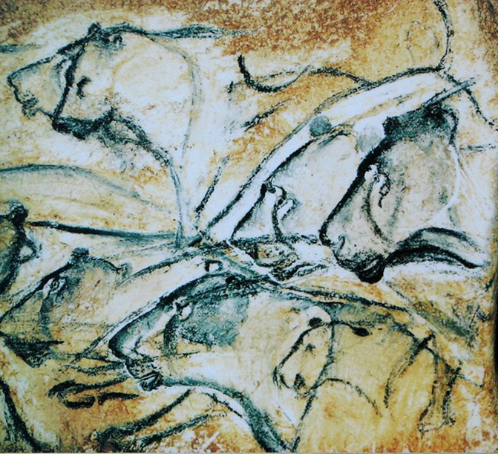
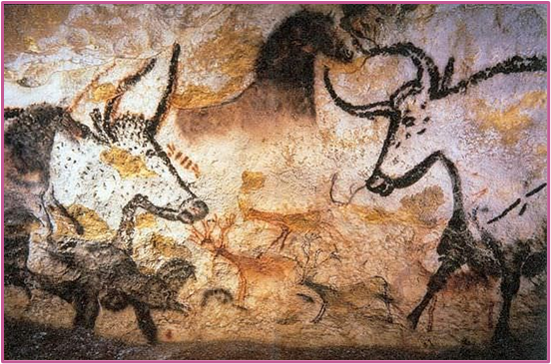
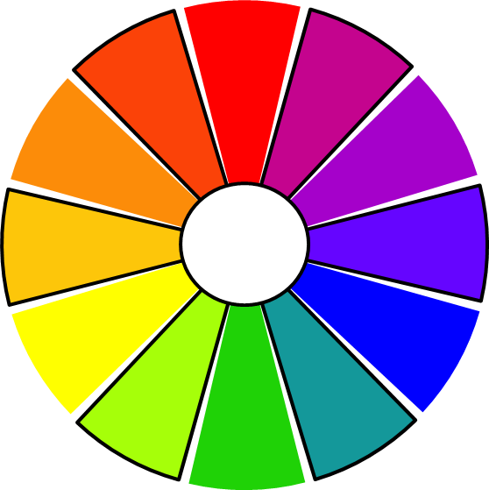
Why Do We Make Art?
The first artists
These artworks are tens of thousands of years old.
When these ancient artworks were discovered, it helped us to learn more about our ancestors. We now know that humans have made art throughout their existence.
Tertiary colours
A tertiary colour is created by mixing a primary colour with a secondary colour.
For example, yellow-orange or blue-purple.
On this colour wheel, the tertiary colours are outlined in black.
Art and Design – Autumn | Knowledge Organiser
Notes:
(Replica of) cave lion drawings from Chauvet cave in Southern France (CC0) - https://commons.wikimedia.org/w/index.php?curid=9667279
Lascaux Cave, Bulls (CC0) - https://commons.wikimedia.org/wiki/File:Lascaux_painting.jpg
Colour Wheel – United Learning

